Slide 1
Sign Language Recognition
CS 725 Project Presentation
Guide: Dr. Preethi Jyothi
Abhishek Kumar Gupta 22M0826
Mrunal Janbandhu 22M0811
Osim Abes 22M0825
Rishabh Singh 22M0762
Saswat Meher 22M0804

Slide 2
Introduction & Problem Statement
Languages can be a barrier for the differently abled
Sign Languages come to the rescue using visual-manual modalities
Need to predict alphabet labels corresponding to visual input signs
Challenge: Generate labels corresponding to live visual feed

Slide 3
Dataset
Sign Language MNIST
27455 training data points
784 Features (28x28)
24 alphabet classes (excluding J& Z )
Grayscale values between 0-255

Slide 4
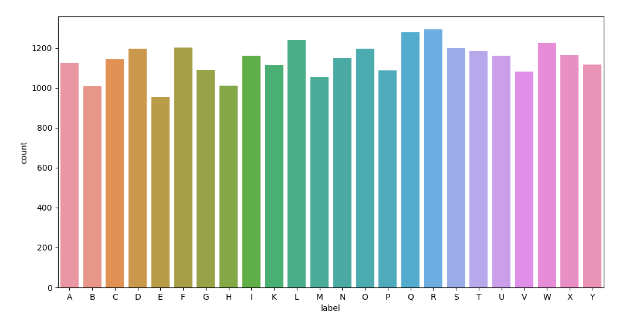
Exploratory Data Analysis
Approximately uniform distribution of data points across all labels
Figure 1: Distribution of labels

Slide 5
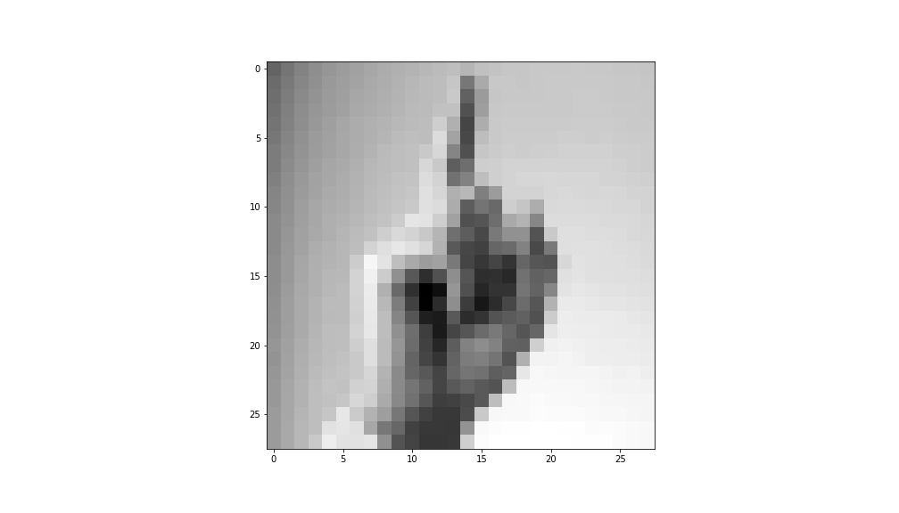
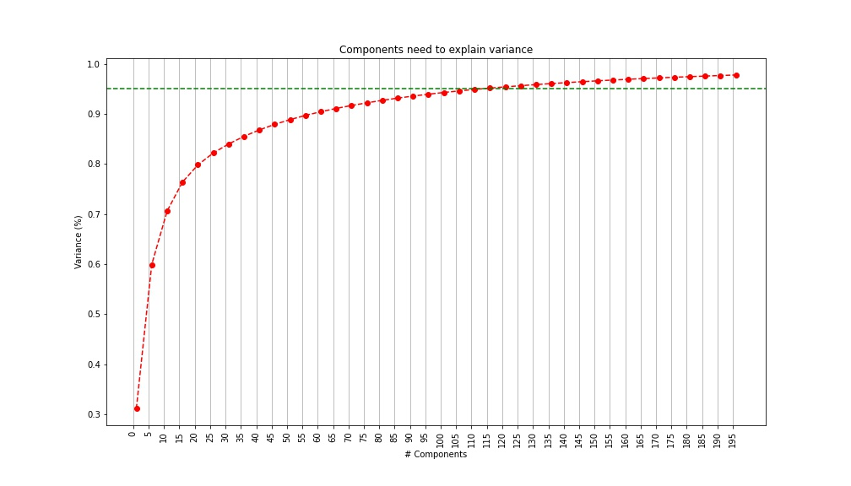
Exploratory Data Analysis(contd.)
Visualization of a data point
95% variability covered with PCA
113 features extracted

Slide 6
Methodology
Non-DL Based Models:
Support Vector Machines
K-Nearest Neighbours
Neural Net-Based Models:
Artificial Neural Network
Known Architecture (AlexNet)
Convolutional Neural Network (with and without Augmentation)

Slide 7
SVM and KNN
Features from PCA were used to train both models.
SVM is designed for binary classification
One-vs-Rest and One-vs-One strategies for multi-class classification.
Data points that have minimum distance in feature space from our new data point.
K such data points are considered, and the most frequent label is given to new points.
Accuracy: KNN-0.81 SVM-0.85

Slide 8
Neural-Net based Models
Artificial Neural Network:
All 784 features passed as input.
3 Hidden layers, 128 Units in each layer
RELU activation in each of the hidden layers
The output layer has 24 nodes with softmax activation.

Slide 9
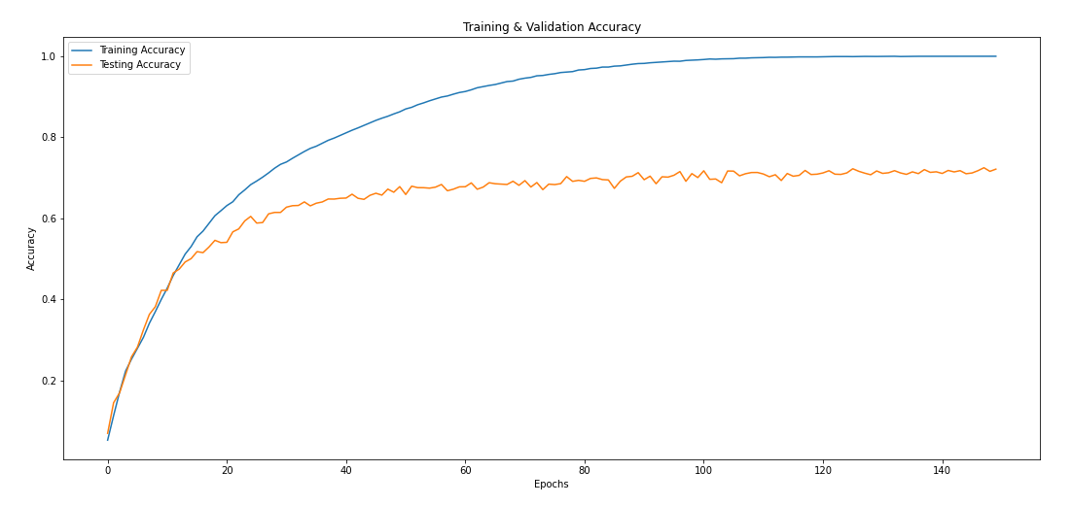
Neural-Net based Models
Artificial Neural Network(contd.):
Figure 2: Training and validation accuracy
Test accuracy: 0.7

Slide 10
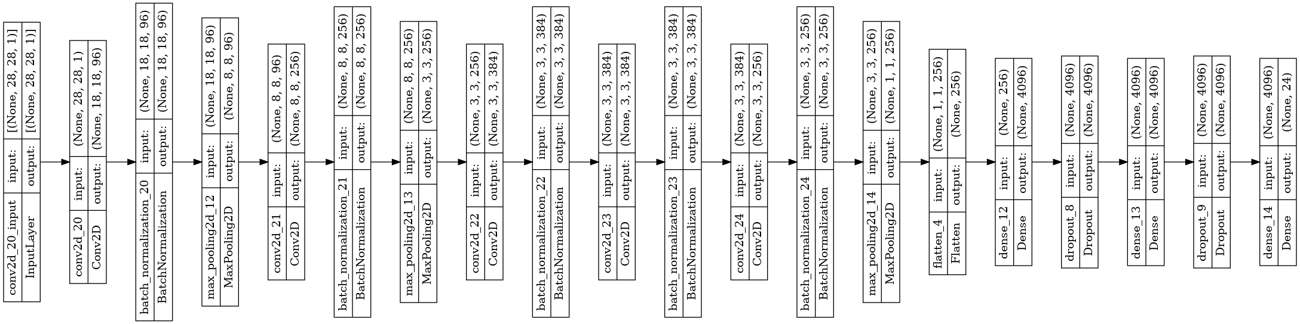
AlexNet
5 Convolution Layers, 3 Max Pooling Layers, 2 Dense Layers
40 epochs, batch sizes of 128
Figure : AlexNet architecture

Slide 11
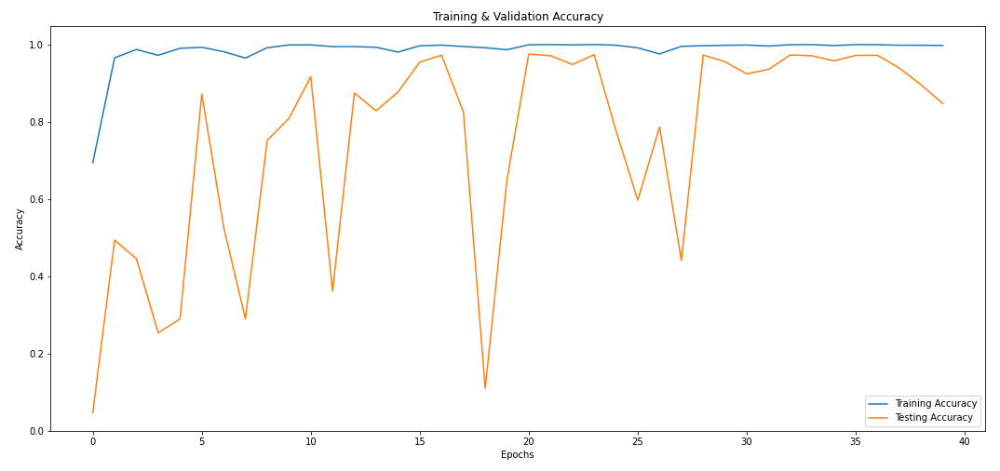
AlexNet
Figure 3: Training and validation accuracy
Test accuracy: 0.83

Slide 12
Custom CNN Model
CNN models with various layers(Dense, Max Pooling etc.) for feature extraction
RELU activation in the Convolution Layers
Cross Entropy Loss as the objective function
3 Convolution Layers with decreasing number of filters, 2 Dense Layers
Test accuracy: 0.97

Slide 13
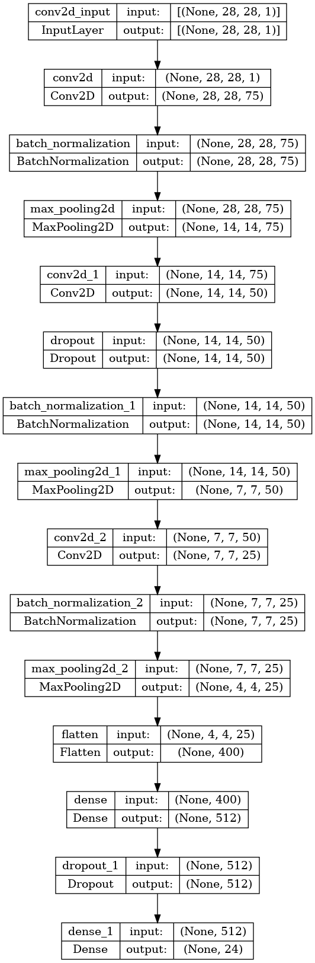
Custom CNN Model
Figure 4: Architecture of custom used CNN Model

Slide 14
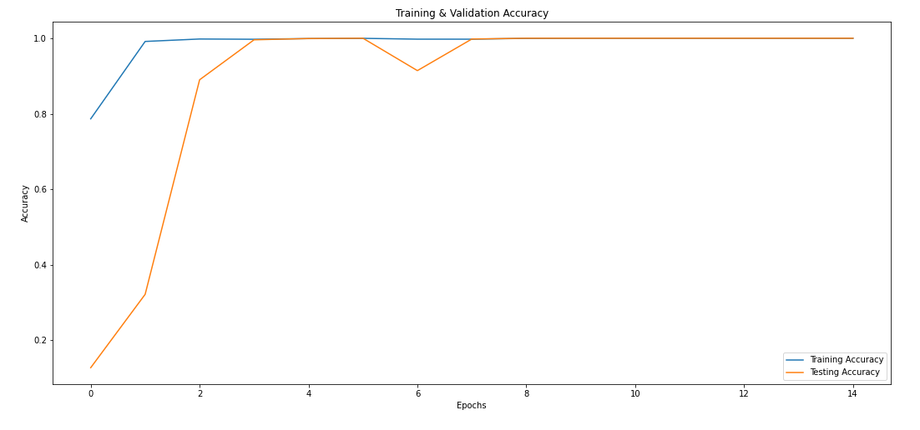
Custom CNN Model
Figure 5: Training and validation accuracy

Slide 15
With Image Augmentation
10 degrees rotation in both directions
The zoom scale varied from 0.9 to 1.1
Width and Height varied by ±10%
Horizontal and Vertical Inversions are avoided.
Test accuracy: ~ 1

Slide 16
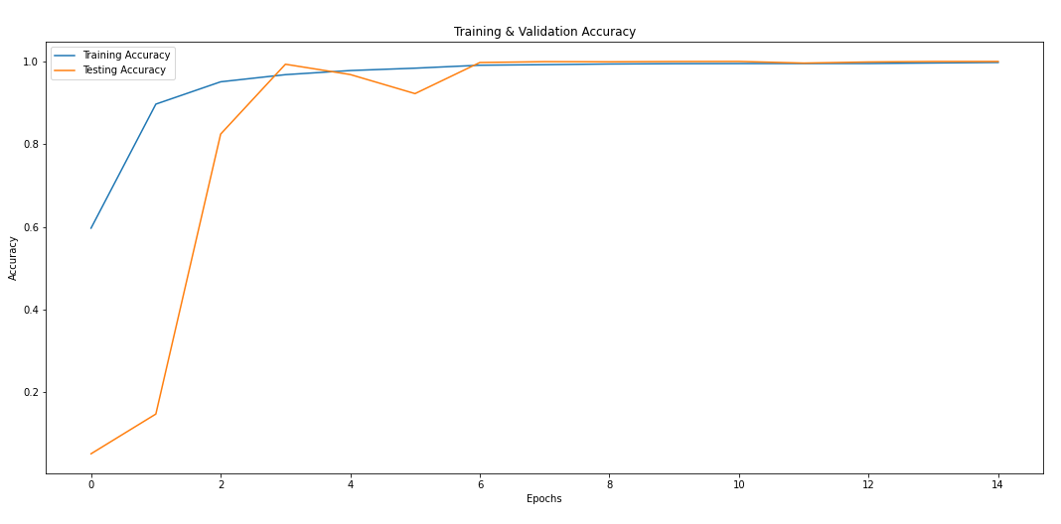
CNN with Augmentation
Figure 6: Training and validation accuracy

Slide 17
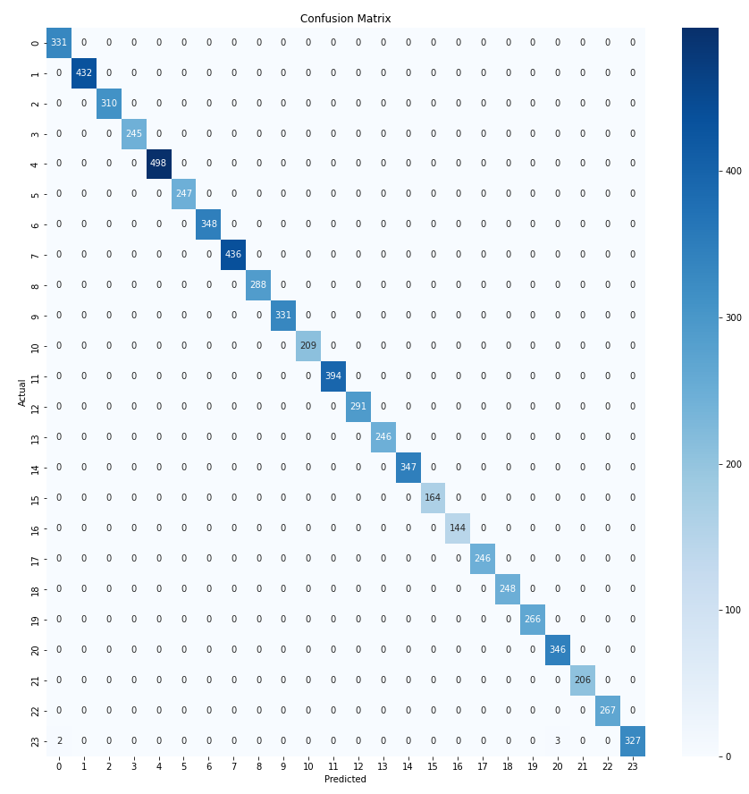

Slide 18
Comparative Analysis
MODEL | Precision | Recall | F1-score
KNN | 0.83 | 0.81 | 0.81
SVM | 0.86 | 0.85 | 0.85
ANN | 0.74 | 0.70 | 0.71
ALEXNET | 0.88 | 0.83 | 0.84
Custom CNN | 0.98 | 0.97 | 0.97
With Augmentation | 1 | 1 | 1

Slide 19
Realtime Recognition
Open CV library for capturing images
Hand gestures extracted using MediaPipe
The captured image scaled to the dimensions of the training data
Gaussian Blur applied to closely resemble training images

Slide 20
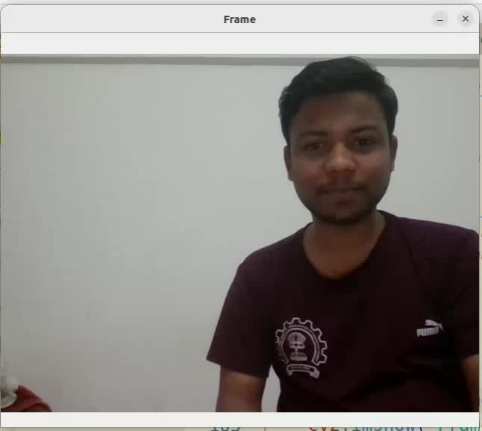
Demonstration

Slide 21
Scope for Future work
Enhancement of Dataset by adding higher dimensional images
Image Pre-Processing for obtaining noise free images
NLP based modelling for sentence completion
Text to Speech for more robust utilities

Slide 22
Reference Links
Code: https://git.cse.iitb.ac.in/mlproject2022/sign-language-classifier
Demo Video: https://drive.google.com/file/d/1sCR7hZPPoqtFKS6So-2k2mpZb_Tp9DUI/view

Slide 23
Contributions
Brainstorming: All team members
SVM and KNN: Mrunal and Rishabh
ANN: Osim and Saswat
AlexNet: Osim, Mrunal and Rishabh
Custom CNN and with Augmentation: Abhishek and Saswat
Realtime Recognition: Saswat and Abhishek

Slide 24
Thank You

